Slide 1
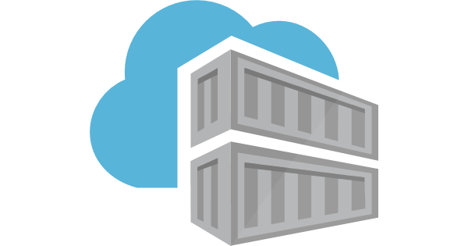
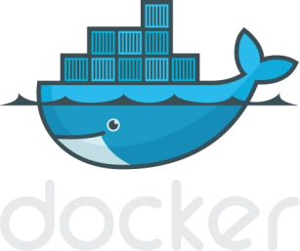
INTRODUCTION TO DOCKER

Slide 2
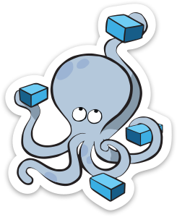
Agenda
Section 1:
What is Docker
What is Docker vs VMs
Basic Docker Commands
Docker file
Section 3:
Networking
Section 2:
Anatomy of a Docker image Docker volumes
Section 4:
Docker compose / stacks
Demo

Slide 3
SECTION 1
What is Docker
Docker vs VMs
Basic Docker Commands

Slide 4
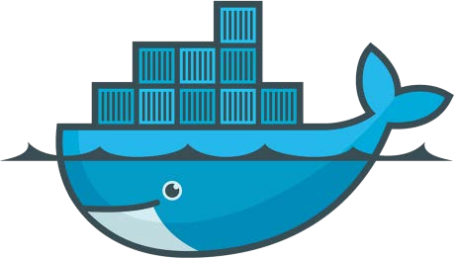
Lightweight, open, secure platform
Simplify building, shipping, running apps
What Is Docker?
Runs natively on Linux or Windows Server
Runs on Windows or Mac Development machines (with a virtual machine)
Relies on "images" and "containers"

Slide 5
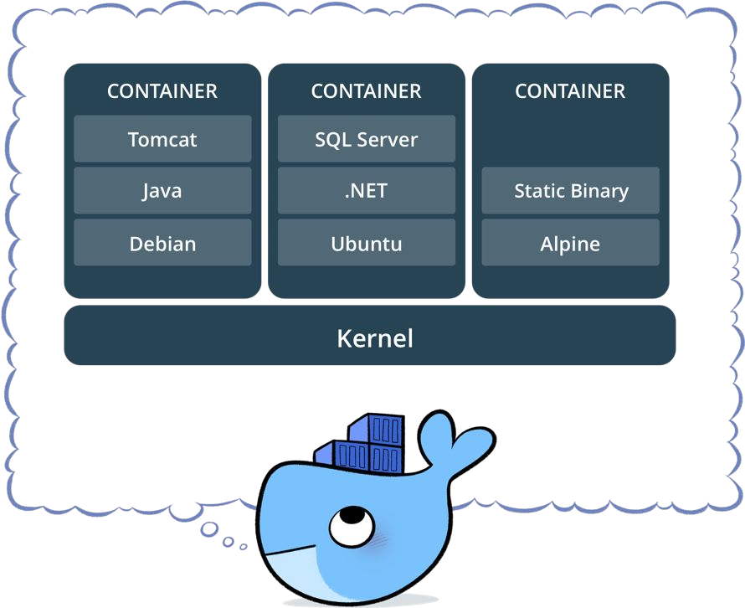
What is a container?
Standardized packaging for software and dependencies
Isolate apps from each other
Share the same OS kernel
Works for all major Linux distributions
Containers native to Windows Server 2016

Slide 6
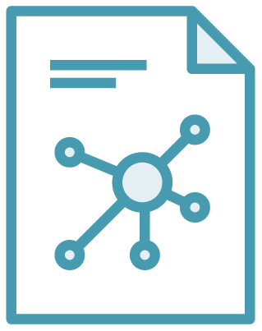

The Role of Images and Containers
Docker Image
Docker Container
Example: Ubuntu with Node.js and Application Code
Created by using an image. Runs your application.

Slide 7


Docker containers are NOT VMs
Easy connection to make
Fundamentally different architectures
Fundamentally different benefits
Virtual Machine
Contenedores

Slide 8
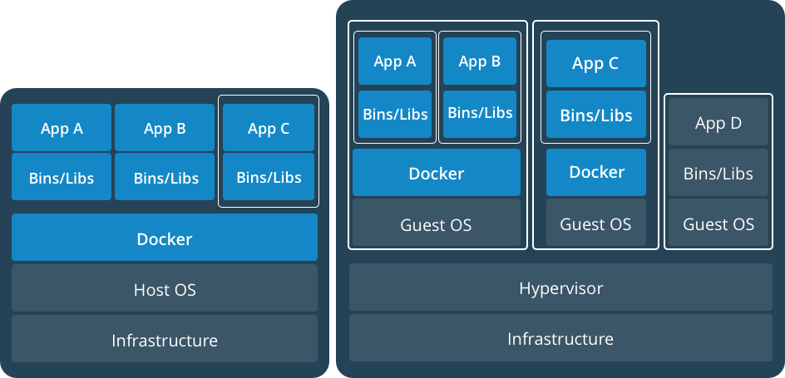
Docker Containers Versus Virtual Machines
App 1
App 2
Bins/Libs
Bins/Libs
Guest OS
Guest OS
App 1
App 2
Bins/Libs
Bins/Libs
Hypervisor
Docker Engine
Host Operating System
Host Operating System
Virtual Machines
Docker Containers

Slide 9

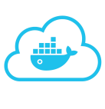














Using Docker: Build, Ship, Run Workflow
Developers IT Operations
BUILD
Development Environments
SHIP
Create & Store Images
RUN
Deploy, Manage, Scale

Slide 10




Some Docker vocabulary
Docker Image
The basis of a Docker container. Represents a full application
Docker Container
The standard unit in which the application service resides and executes
Docker Engine
Creates, ships and runs Docker containers deployable on a physical or virtual, host locally, in a datacenter or cloud service provider
Registry Service (Docker Hub(Public) or Docker Trusted Registry(Private))
Cloud or server based storage and distribution service for your images

Slide 11
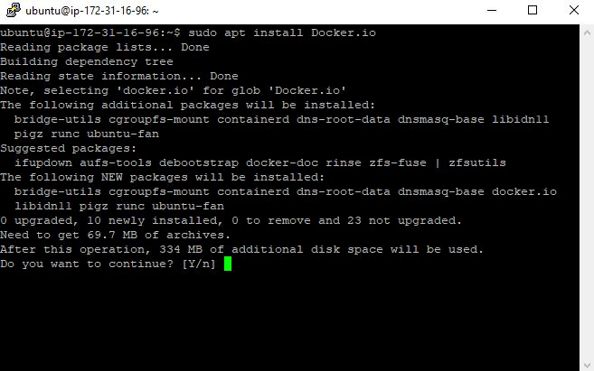
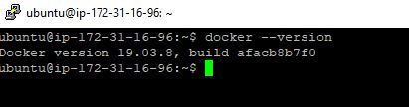
Basic Docker Commands
$ sudo apt install docker.io
$ docker --version

Slide 12
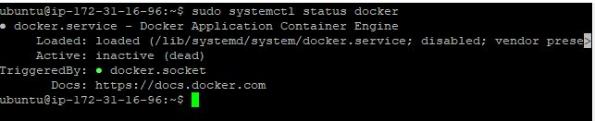
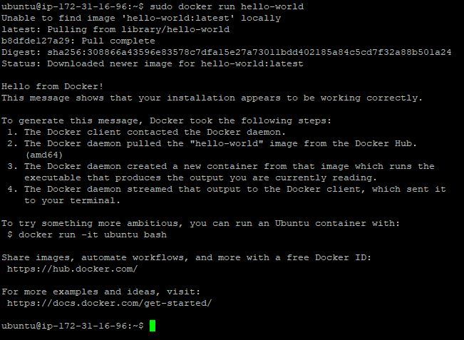
$ sudo systemctl status docker
$ sudo docker run hello-world

Slide 13

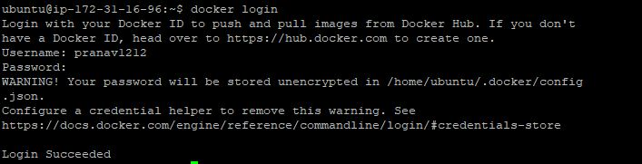
$ sudo docker images
$ sudo docker ps (or) $ sudo docker ps -a
$ docker login(with docker hub)

Slide 14
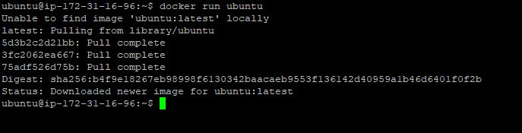
$ docker run ubuntu
$ docker run –it –d ubuntu

Slide 15
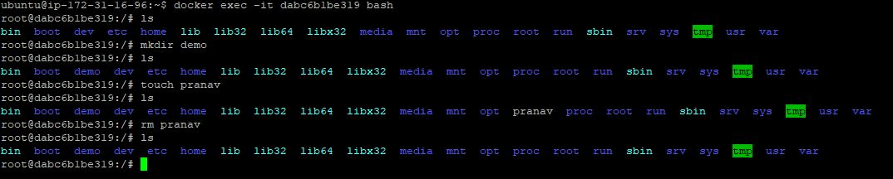
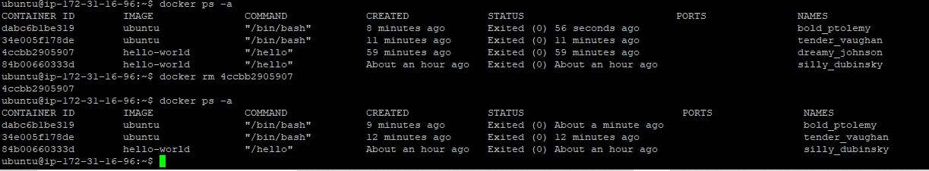
$ docker exec –it <container id> bash
$ docker stop <container id>
$ docker rm <conatiner id>

Slide 16
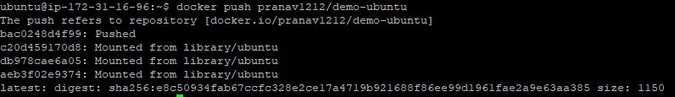
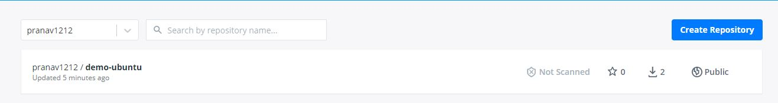
$ docker commit <container id> <user name/image name>
$ docker push <user name/ image name>
Checking the pushed Repository at Docker hub

Slide 17
SECTION 2
Anatomy of a Docker Container
Docker Volumes
Volume Use Cases

Slide 18
Each Dockerfile Command Creates a Layer
…
EXPOSE
COPY
WORKDIR
RUN
FROM
Kernel

Slide 19
Docker Volumes
Volumes mount a directory on the host into the container at a specific location
Can be used to share (and persist) data between containers
Directory persists after the container is deleted
Unless you explicitly delete it
Can be created in a Dockerfile

Slide 20
Why Use Volumes
Mount local source code into a running container
docker container run -v $(pwd):/usr/src/app/ myapp
Improve performance
− As directory structures get complicated traversing the tree can slow system performance
Data persistence

Slide 21
SECTION 3
Networking

Slide 22

What is Docker Bridge Networking
Docker host
Docker host
Cntnr 1
Cntnr 2
Cntnr 3
Cntnr 4
Cntnr 5
Cntnr 6
Cntnr 7
bridgenet1
bridgenet2
bridgenet3
docker network create -d bridge --name bridgenet1

Slide 23


Docker Bridge Networking and Port Mapping
Docker host 1
Host port
Container port
Cntnr1
10.0.0.8
:80
$ docker container run -p 8080:80 ...
Bridge
172.14.3.55
:8080
L2/L3 physical network

Slide 24
SECTION 4
Docker Compose

Slide 25




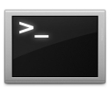







Docker Compose: Multi Container Applications
Build and run one container at a time
Manually connect containers together
Must be careful with dependencies and start up order
Define multi container app in compose.yml file
Single command to deploy entire app
Handles container dependencies
Works with Docker Swarm, Networking, Volumes, Universal Control Plane

Slide 26

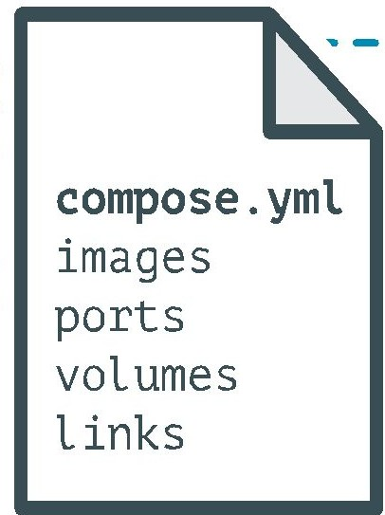
Docker Compose: Multi Container Applications
nginx:
image: nginx:latest
ports: -
8080:80
volumes:
-./code:/code - .
-/site.conf:/etc/nginx/conf.d/site.conf
links:
- php
php:
image: php:7-fpm
volumes:
- ./code:/code

Slide 27

THANK YOU!

